Slide 1

Introduction to Probability and Statistics
Twelfth Edition
Robert J. Beaver • Barbara M. Beaver • William Mendenhall
Presentation designed and written by:
Barbara M. Beaver

Slide 2
Introduction to Probability and Statistics
Twelfth Edition
Chapter 13
Multiple Regression Analysis
Some graphic screen captures from Seeing Statistics ®
Some images © 2001-(current year) www.arttoday.com

Slide 3

Introduction
We extend the concept of simple linear regression as we investigate a response y which is affected by several independent variables, x₁, x₂, x₃,…, x_{k}.
Our objective is to use the information provided by the x_{i} to predict the value of y.

Slide 4
Example
Let y be a student’s college achievement, measured by his/her GPA. This might be a function of several variables:
  x₁ = rank in high school class
  x₂ = high school’s overall rating
  x₃ = high school GPA
  x₄ = SAT scores
We want to predict y using knowledge of x₁, x₂, x₃ and x₄.

Slide 5

Example
Let y be the monthly sales revenue for a company. This might be a function of several variables:
  x₁ = advertising expenditure
  x₂ = time of year
  x₃ = state of economy
  x₄ = size of inventory
We want to predict y using knowledge of x₁, x₂, x₃ and x₄.

Slide 6
Some Questions
How well does the model fit?
How strong is the relationship between y and the predictor variables?
Have any assumptions been violated?
How good are the estimates and predictions?
We collect information using n observations on the response y and the independent variables, x₁, x₂, x₃, …x_{k}.

Slide 7
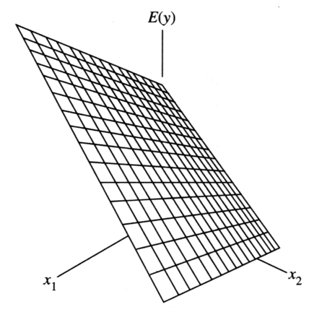
The General
Linear Model
  y = β₀+ β₁x₁ + β₂x₂ +…+ β_{k}x_{k} + ε
where
y is the response variable you want to predict.
β₀, β₁, β₂,..., β_{k} are unknown constants
x₁, x₂,..., x_{k} are independent predictor variables, measured without error.

Slide 8
The Random Error
The deterministic part of the model,
  E(y) = β₀+ β₁x₁ + β₂x₂ +…+ β_{k}x_{k} ,
describes average value of y for any fixed values of x₁, x₂,..., x_{k} . The population of measurements is generated as y deviates from the line of means
by an amount ε. We assume
  ε are independent
  Have a mean 0 and common variance σ² for any set x₁, x₂,..., x_{k .}
  Have a normal distribution.

Slide 9
Example
Consider the model E(y) = β₀+ β₁x₁ + β₂x₂
This is a first order model (independent variables appear only to the first power).
β₀ = y-intercept = value of E(y) when x₁=x₂=0.
β₁ and β₂ are the partial regression coefficients—the change in y for a one-unit change in x_{i} when the other independent variables are held constant.
Traces a plane in three dimensional space.

Slide 10
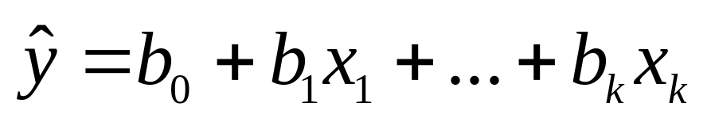
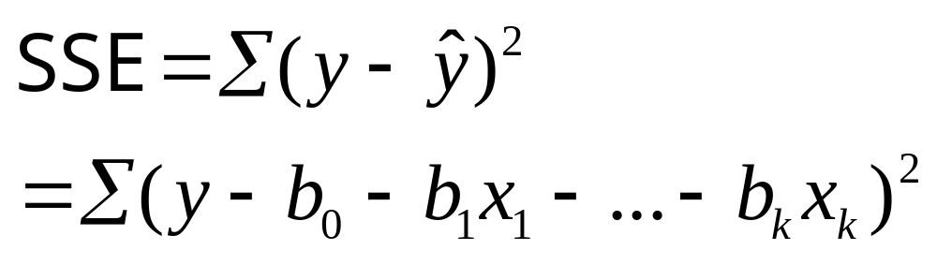
The Method of
Least Squares
The best-fitting prediction equation is calculated using a set of n measurements (y, x₁, x₂ ,… x_{k}) as
We choose our estimates b₀, b₁,…, b_{k} to estimate β₀, β₁,…, β_{k} to minimize

Slide 11

Example
A computer database in a small community contains the listed selling price y (in thousands of dollars), the amount of living area x₁ (in hundreds of square feet), and the number of floors x₂, bedrooms x₃, and bathrooms x₄, for n = 15 randomly selected residences currently on the market.
Property | y | x₁ | x₂ | x₃ | x₄
1 | 69.0 | 6 | 1 | 2 | 1
2 | 118.5 | 10 | 1 | 2 | 2
3 | 116.5 | 10 | 1 | 3 | 2
… | … | … | … | … | …
15 | 209.9 | 21 | 2 | 4 | 3
Fit a first order model to the data using the method of least squares.

Slide 12
Example
The first order model is
E(y) = β₀+ β₁x₁ + β₂x₂ + β₃x₃ + β₄x₄
fit using Minitab with the values of y and the four independent variables entered into five columns of the Minitab worksheet.
Regression equation
Regression Analysis: ListPrice versus SqFeet, NumFlrs, Bdrms, Baths
The regression equation is
ListPrice = 18.8 + 6.27 SqFeet - 16.2 NumFlrs - 2.67 Bdrms + 30.3 Baths
Predictor Coef SE Coef T P
Constant 18.763 9.207 2.04 0.069
SqFeet 6.2698 0.7252 8.65 0.000
NumFlrs -16.203 6.212 -2.61 0.026
Bdrms -2.673 4.494 -0.59 0.565
Baths 30.271 6.849 4.42 0.001
Partial regression coefficients

Slide 13
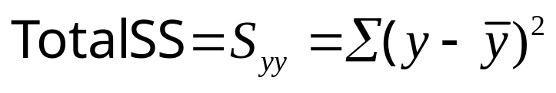
The Analysis of Variance
The total variation in the experiment is measured by the total sum of squares:
The Total SS is divided into two parts:
SSR (sum of squares for regression): measures the variation explained by using the regression equation.
SSE (sum of squares for error): measures the leftover variation not explained by the independent variables.

Slide 14
The ANOVA Table
Total df = Mean Squares
Regression df =
Error df =
n -1
k
MSR = SSR/k
n –1 – k = n – k -1
MSE = SSE/(n-k-1)
Source | df | SS | MS | F
Regression | k | SSR | SSR/k | MSR/MSE
Error | n – k -1 | SSE | SSE/(n-k-1)
Total | n -1 | Total SS

Slide 15
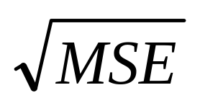
The Real Estate Problem
Another portion of the Minitab printout shows the ANOVA Table, with n = 15 and k = 4.
S = 6.84930 R-Sq = 97.1% R-Sq(adj) = 96.0%
Analysis of Variance
Source DF SS MS F P
Regression 4 15913.0 3978.3 84.80 0.000
Residual Error 10 469.1 46.9
Total 14 16382.2
Source DF Seq SS
SqFeet 1 14829.3
NumFlrs 1 0.9
Bdrms 1 166.4
Baths 1 916.5
Sequential Sums of squares: conditional contribution of each independent variable to SSR given the variables already entered into the model.

Slide 16
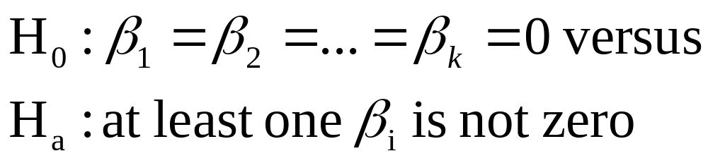
Testing the Usefulness of the Model
The first question to ask is whether the regression model is of any use in predicting y.
If it is not, then the value of y does not change, regardless of the value of the independent variables, x₁, x₂ ,…, x_{k.} This implies that the partial regression coefficients, β₁, β₂,…, β_{k} are all zero.

Slide 17
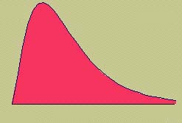
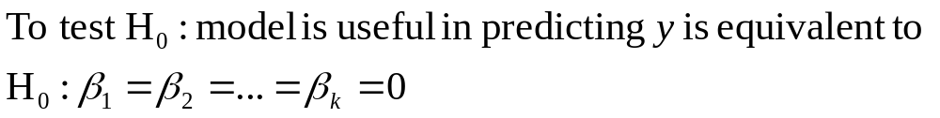
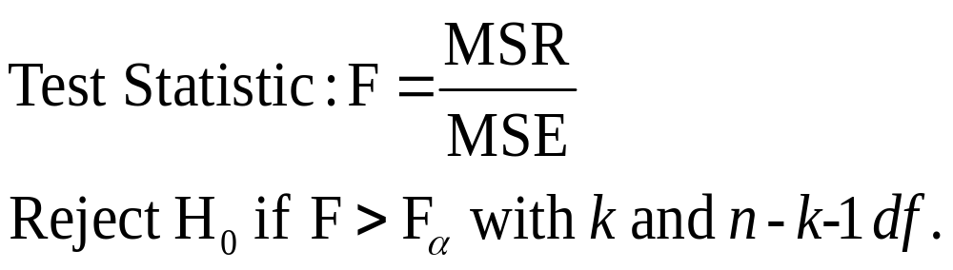
The F Test
You can test the overall usefulness of the model using an F test. If the model is useful, MSR will be large compared to the unexplained variation, MSE.

Slide 18
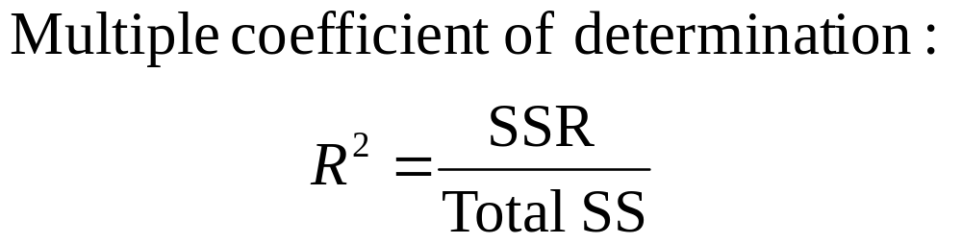
Measuring the Strength of the Relationship
If the independent variables are useful in predicting y, you will want to know how well the model fits.
The strength of the relationship between x and y can be measured using:

Slide 19
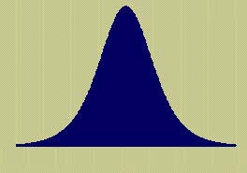
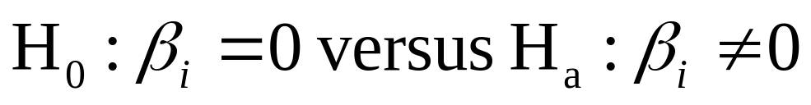
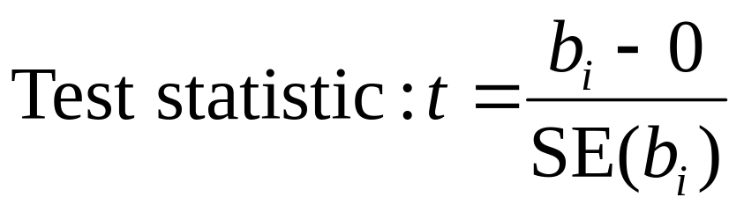
Testing the Partial Regression Coefficients
Is a particular independent variable useful in the model, in the presence of all the other independent variables? The test statistic is function of b_{i}, our best estimate of β_{i}.
which has a t distribution with error df = n – k –1.

Slide 20
The Real Estate Problem
Is the overall model useful in predicting list price? How much of the overall variation in the response is explained by the regression model?
S = 6.84930 R-Sq = 97.1% R-Sq(adj) = 96.0%
Analysis of Variance
Source DF SS MS F P
Regression 4 15913.0 3978.3 84.80 0.000
Residual Error 10 469.1 46.9
Total 14 16382.2
Source DF Seq SS
SqFeet 1 14829.3
NumFlrs 1 0.9
Bdrms 1 166.4
Baths 1 916.5
R² = .971 indicates that 97.1% of the overall variation is explained by the regression model.
F = MSR/MSE = 84.80 with p-value = .000 is highly significant. The model is very useful in predicting the list price of homes.

Slide 21
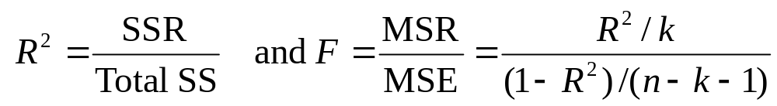
Measuring the Strength of the Relationship
Since Total SS = SSR + SSE, R² measures
the proportion of the total variation in the responses that can be explained by using the independent variables in the model.
the percent reduction the total variation by using the regression equation rather than just using the sample mean y-bar to estimate y.

Slide 22
The Real Estate Problem
To test H₀: β₃ = 0, the test statistic is t = -0.59 with p-value = .565.
The p-value is larger than .05 and H₀ is not rejected.
We cannot conclude that number of bedrooms is a valuable predictor in the presence of the other variables.
Perhaps the model could be refit without x₃.
In the presence of the other three independent variables, is the number of bedrooms significant in predicting the list price of homes? Test using α = .05.
Regression Analysis: ListPrice versus SqFeet, NumFlrs, Bdrms, Baths
The regression equation is
ListPrice = 18.8 + 6.27 SqFeet - 16.2 NumFlrs - 2.67 Bdrms + 30.3 Baths
Predictor Coef SE Coef T P
Constant 18.763 9.207 2.04 0.069
SqFeet 6.2698 0.7252 8.65 0.000
NumFlrs -16.203 6.212 -2.61 0.026
Bdrms -2.673 4.494 -0.59 0.565
Baths 30.271 6.849 4.42 0.001

Slide 23
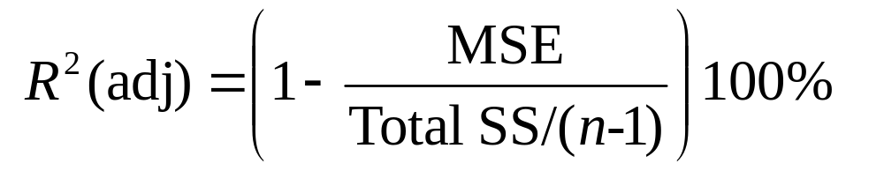
Comparing
Regression Models
The strength of a regression model is measured using R² = SSR/Total SS. This value will only increase as variables are added to the model.
To fairly compare two models, it is better to use a measure that has been adjusted using df:

Slide 24
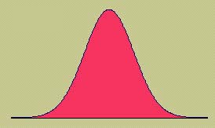
Checking the
Regression Assumptions
Remember that the results of a regression analysis are only valid when the necessary assumptions have been satisfied.
  ε are independent
  Have a mean 0 and common variance σ² for any set x₁, x₂,..., x_{k .}
  Have a normal distribution.

Slide 25
Diagnostic Tools
We use the same diagnostic tools used in Chapter 11 and 12 to check the normality assumption and the assumption of equal variances.
Normal probability plot of residuals
2. Plot of residuals versus fit or residuals versus variables

Slide 26
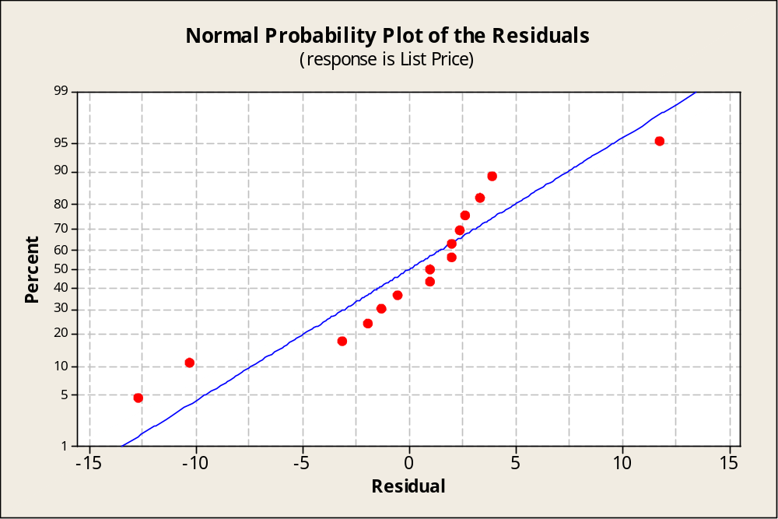
Normal Probability Plot
If the normality assumption is valid, the plot should resemble a straight line, sloping upward to the right.
If not, you will often see the pattern fail in the tails of the graph.

Slide 27
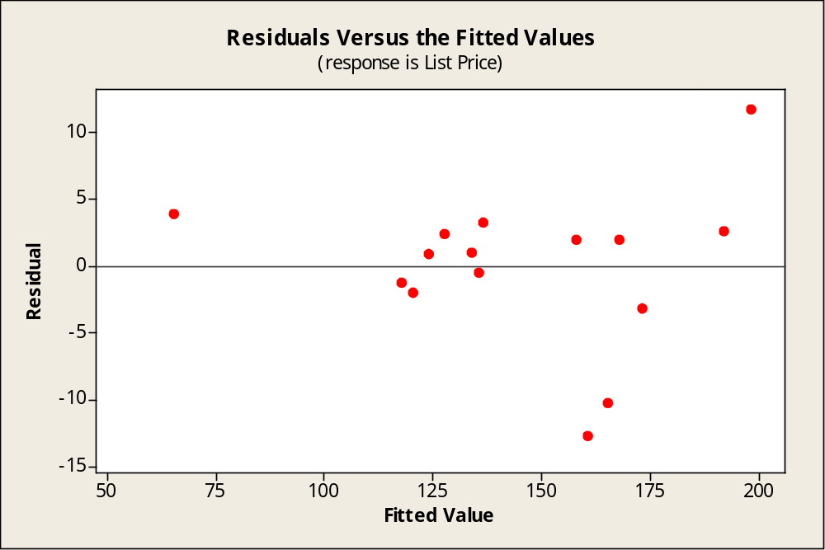
Residuals versus Fits
If the equal variance assumption is valid, the plot should appear as a random scatter around the zero center line.
If not, you will see a pattern in the residuals.

Slide 28
Estimation and Prediction
Once you have
  determined that the regression line is useful
  used the diagnostic plots to check for violation of the regression assumptions.
You are ready to use the regression line to
  Estimate the average value of y for a given value of x
  Predict a particular value of y for a given value of x.

Slide 29
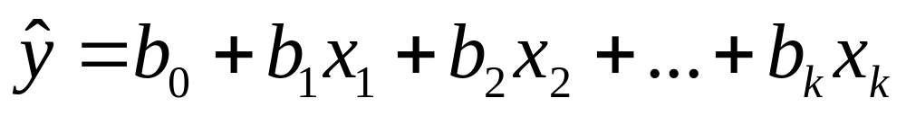
Estimation and Prediction
Enter the appropriate values of x₁, x₂, …, x_{k} in Minitab. Minitab calculates
and both the confidence interval and the prediction interval.
Particular values of y are more difficult to predict, requiring a wider range of values in the prediction interval.

Slide 30
The Real Estate Problem
Estimate the average list price for a home with 1000 square feet of living space, one floor, 3 bedrooms and two baths with a 95% confidence interval.
We estimate that the average list price will be between $110,860 and $124,700 for a home like this.
Predicted Values for New Observations
New Obs Fit SE Fit 95% CI 95% PI
1 117.78 3.11 ( 110.86, 124.70) ( 101.02, 134.54)
Values of Predictors for New Observations
New Obs SqFeet NumFlrs Bdrms Baths
1 10.0 1.00 3.00 2.00

Slide 31
Using Regression Models
When you perform multiple regression analysis,
use a step-by step approach:
1. Obtain the fitted prediction model.
2. Use the analysis of variance F test and R ² to determine how well the model fits the data.
3. Check the t tests for the partial regression coefficients to see which ones are contributing significant information in the presence of the others.
4. If you choose to compare several different models, use
R ²(adj) to compare their effectiveness.
5. Use diagnostic plots to check for violation of the regression assumptions.

Slide 32
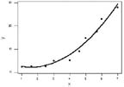
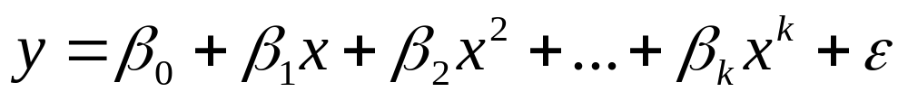
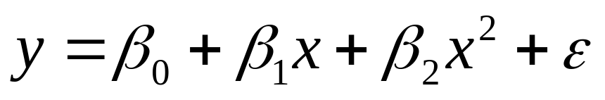
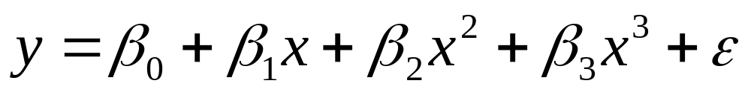
A Polynomial Model
A response y is related to a single independent variable x, but not in a linear manner. The polynomial model is:
When k = 2, the model is quadratic:
When k = 3, the model is cubic:

Slide 33

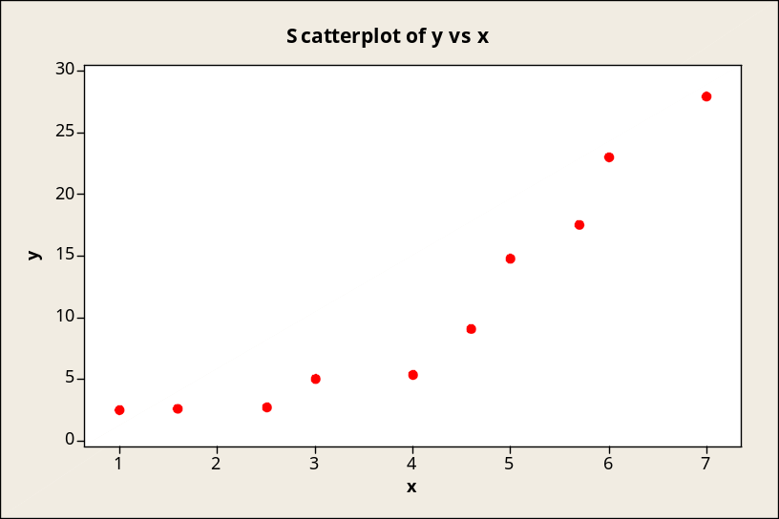
Example
A market research firm has observed the sales (y) as a function of mass media advertising expenses (x) for 10 different companies selling a similar product.
Company | 1 | 2 | 3 | 4 | 5 | 6 | 7 | 8 | 9 | 10
Expenditure, x | 1.0 | 1.6 | 2.5 | 3.0 | 4.0 | 4.6 | 5.0 | 5.7 | 6.0 | 7.0
Sales, y | 2.5 | 2.6 | 2.7 | 5.0 | 5.3 | 9.1 | 14.8 | 17.5 | 23.0 | 28.0
Since there is only one independent variable, you could fit a linear, quadratic, or cubic polynomial model. Which would you pick?

Slide 34
Two Possible Choices
A straight line model: y = β₀ + β₁x + ε
A quadratic model: y = β₀ + β₁x + β₂x² + ε
Here is the Minitab printout for the straight line:
Overall F test is highly significant, as is the t-test of the slope. R² = .856 suggests a good fit. Let’s check the residual plots…
Regression Analysis: y versus x
The regression equation is
y = - 6.47 + 4.34 x
Predictor Coef SE Coef T P
Constant -6.465 2.795 -2.31 0.049
x 4.3355 0.6274 6.91 0.000
S = 3.72495 R-Sq = 85.6% R-Sq(adj) = 83.9%
Analysis of Variance
Source DF SS MS F P
Regression 1 662.46 662.46 47.74 0.000
Residual Error 8 111.00 13.88
Total 9 773.46

Slide 35
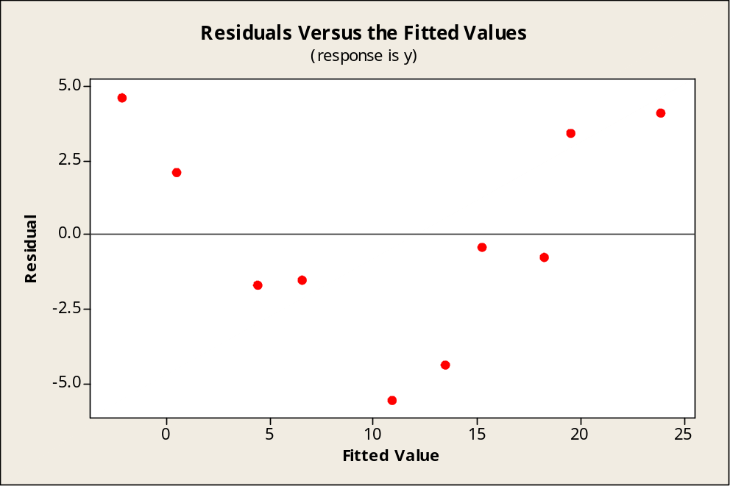
Example
There is a strong pattern of a “curve” leftover in the residual plot.
This indicates that there is a curvilinear relationship unaccounted for by your straight line model.
You should have used the quadratic model!
Use Minitab to fit the quadratic model:
y = β₀ + β₁x + β₂x² + ε

Slide 36
The Quadratic Model
Regression Analysis: y versus x, x-sq
The regression equation is
y = 4.66 - 3.03 x + 0.939 x-sq
Predictor Coef SE Coef T P
Constant 4.657 2.443 1.91 0.098
x -3.030 1.395 -2.17 0.067
x-sq 0.9389 0.1739 5.40 0.001
S = 1.75204 R-Sq = 97.2% R-Sq(adj) = 96.4%
Analysis of Variance
Source DF SS MS F P
Regression 2 751.98 375.99 122.49 0.000
Residual Error 7 21.49 3.07
Total 9 773.47
Overall F test is highly significant, as is the t-test of the quadratic term β₂. R² = .972 suggests a very good fit.
Let’s compare the two models, and check the residual plots.

Slide 37
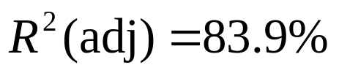
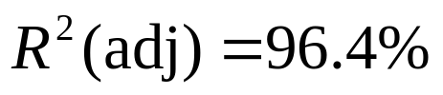
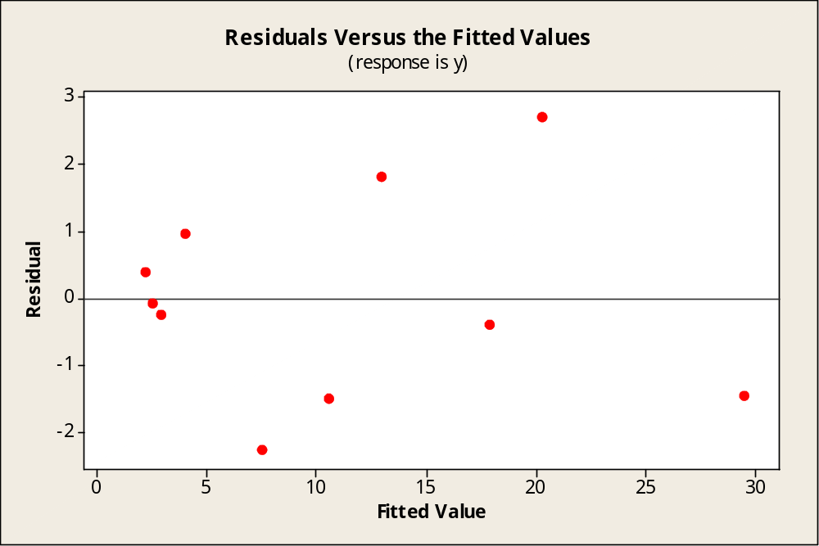
Which Model to Use?
Use R²(adj) to compare the models:
The straight line model: y = β₀ + β₁x + ε
The quadratic model: y = β₀ + β₁x + β₂x² + ε
The quadratic model is better.
There are no patterns in the residual plot, indicating that this is the correct model for the data.

Slide 38
Using Qualitative
Variables
Multiple regression requires that the response y be a quantitative variable.
Independent variables can be either quantitative or qualitative.
Qualitative variables involving k categories are entered into the model by using k-1 dummy variables.
Example: To enter gender as a variable, use
  x_{i} = 1 if male; 0 if female

Slide 39
Example
Data was collected on 6 male and 6 female assistant professors. The researchers recorded their salaries (y) along with years of experience (x₁). The professor’s gender enters into the model as a dummy variable: x₂ = 1 if male; 0 if not.
Professor | Salary, y | Experience, x₁ | Gender, x₂ | Interaction, x₁x₂
1 | $50,710 | 1 | 1 | 1
2 | 49,510 | 1 | 0 | 0
… | … | … | … | …
11 | 55,590 | 5 | 1 | 5
12 | 53,200 | 5 | 0 | 0

Slide 40
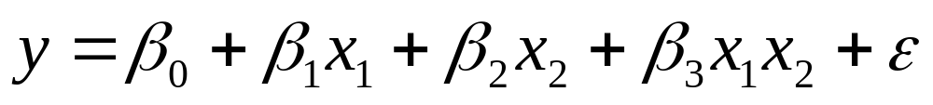
Example
We want to predict a professor’s salary based on years of experience and gender. We think that there may be a difference in salary depending on whether you are male or female.
The model we choose includes experience (x₁), gender (x₂), and an interaction term (x₁x₂) to allow salary’s for males and females to behave differently.

Slide 41
Minitab Output
What is the regression equation for males? For females?
For males, x₂ = 1,
y = 49459.7 + 1229.13x₁
For females, x₂ = 0,
y = 48593.0 + 969.0x₁
Two different straight line models.
Is the overall model useful in predicting y?
The overall F test is F = 346.24 with p-value = .000. The value of R² = .992 indicates that the model fits very well.
We use Minitab to fit the model.
Regression Analysis: y versus x1, x2, x1x2
The regression equation is
y = 48593 + 969 x1 + 867 x2 + 260 x1x2
Predictor Coef SE Coef T P
Constant 48593.0 207.9 233.68 0.000
x1 969.00 63.67 15.22 0.000
x2 866.7 305.3 2.84 0.022
x1x2 260.13 87.06 2.99 0.017
S = 201.344 R-Sq = 99.2% R-Sq(adj) = 98.9%
Analysis of Variance
Source DF SS MS F P
Regression 3 42108777 14036259 346.24 0.000
Residual Error 8 324315 40539
Total 11 42433092
Is there a difference in the relationship between salary and years of experience, depending on the gender of the professor?
Yes. The individual t-test for the interaction term is t = 2.99 with p-value = .017. This indicates a significant interaction between gender and years of experience.

Slide 42
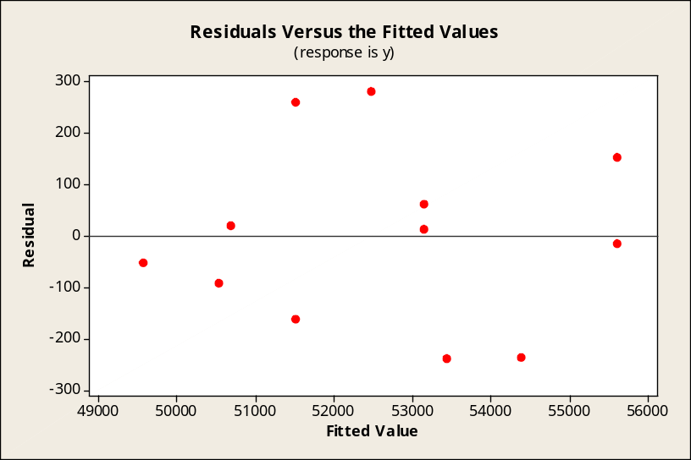
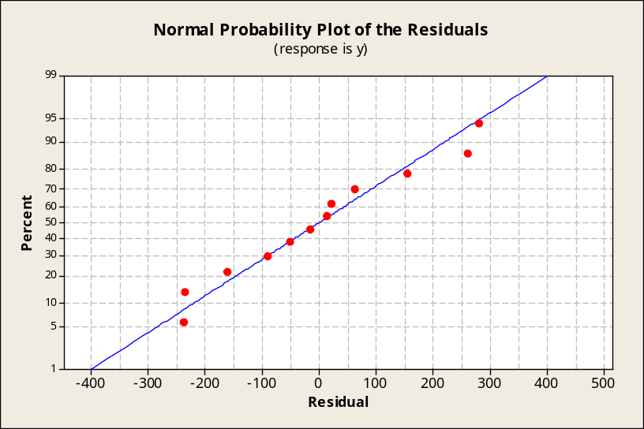
Example
It does not appear from the diagnostic plots that there are any violations of assumptions.
The model is ready to be used for prediction or estimation.
Have any of the regression assumptions been violated, or have we fit the wrong model?

Slide 43
Testing Sets of Parameters
Suppose the demand y may be related to five independent variables, but that the cost of measuring three of them is very high.
If it could be shown that these three contribute little or no information, they can be eliminated.
You want to test the null hypothesis
H₀ : β₃ = β₄ = β₅ = 0—that is, the independent variables x₃, x₄, and x₅ contribute no information for the prediction of y—versus the alternative hypothesis:
H_{a} : At least one of the parameters β₃, β₄, or β₅ differs from 0 —that is, at least one of the variables x₃, x₄, or x₅ contributes information for the prediction of y.

Slide 44
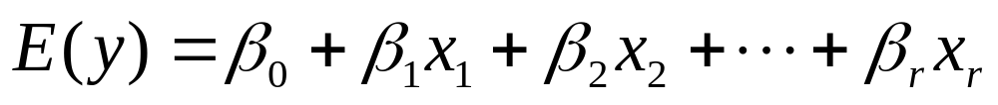
Testing Sets of Parameters
To explain how to test a hypothesis concerning a set of model parameters, we define two models:
Model One (reduced model)
  Model Two (complete model)
terms in model 1 additional terms in model 2

Slide 45
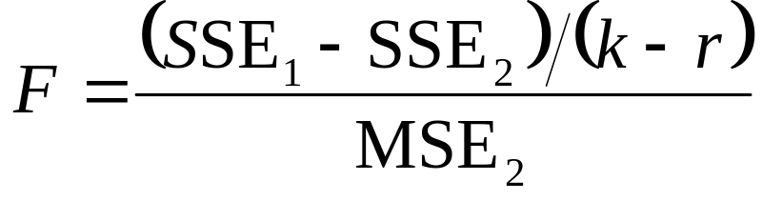
Testing Sets of Parameters
The test of the hypothesis
H₀ : β₃ = β₄ = β₅ = 0
H_{a} : At least one of the β_{i} differs from 0
uses the test statistic
where F is based on df₁ = (k - r ) and df₂ =
n -(k + 1).
The rejection region for the test is identical to
other analysis of variance F tests, namely F > F_{α}.

Slide 46
Stepwise Regression
A stepwise regression analysis fits a variety
of models to the data, adding and deleting variables as their significance in the presence of the other variables is either significant or nonsignificant, respectively.
Once the program has performed a sufficient number of iterations and no more variables are significant when added to the model, and none of the variables are nonsignificant when removed, the procedure stops.
These programs always fit first-order models and are not helpful in detecting curvature or interaction in the data.

Slide 47
Some Cautions
Causality: Be careful not to deduce a causal relationship between a response y and a variable x.
Multicollinearity: Neither the size of a regression coefficient nor its t-value indicates the importance of the variable as a contributor of information. This may be because two or more of the predictor variables are highly correlated with one another; this is called multicollinearity.

Slide 48
Multicollinearity
Multicollinearity can have these effects on the analysis:
  The estimated regression coefficients will have large standard errors, causing imprecision in confidence and prediction intervals.
  Adding or deleting a predictor variable may cause significant changes in the values of the other regression coefficients.

Slide 49
Multicollinearity
How can you tell whether a regression analysis exhibits multicollinearity?
  The value of R ² is large, indicating a good fit, but the individual t-tests are nonsignificant.
  The signs of the regression coefficients are contrary to what you would intuitively expect the contributions of those variables to be.
  A matrix of correlations, generated by the computer, shows you which predictor variables are highly correlated with each other and with the response y.

Slide 50
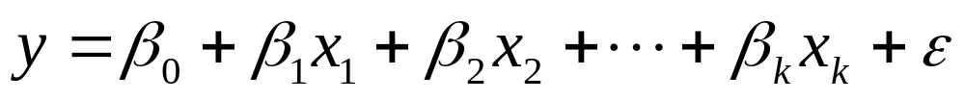

Key Concepts
I. The General Linear Model
1.
2. The random error ε has a normal distribution with mean 0
and variance σ².
II. Method of Least Squares
1. Estimates b ₀, b ₁, …, b _{k} for β ₀, β ₁, …, β _{k} , are chosen to
minimize SSE, the sum of squared deviations about the
regression line
2. Least-squares estimates are produced by computer.

Slide 51
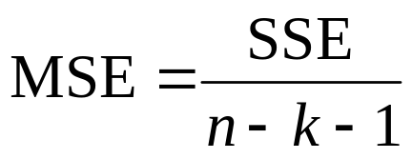
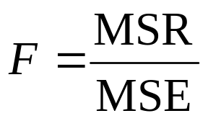
Key Concepts
III. Analysis of Variance
1. Total SS = SSR + SSE, where Total SS = S_{yy}.
The ANOVA table is produced by computer.
2. Best estimate of σ² is
IV. Testing, Estimation, and Prediction
1. A test for the significance of the regression,
H₀ : β₁ = β₂ = … = β_{k} = 0, can be implemented using the
analysis of variance F test:

Slide 52
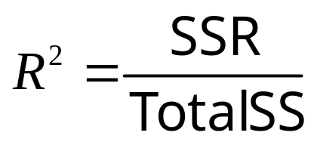
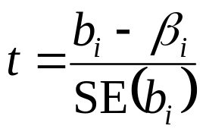
Key Concepts
2. The strength of the relationship between x and y can be measured using
which gets closer to 1 as the relationship gets stronger.
3. Use residual plots to check for nonnormality, inequality of variances, and an incorrectly fit model.
4. Significance tests for the partial regression coefficients can be performed using the Student’s t test with error d f = n − k − 1:

Slide 53
Key Concepts
5. Confidence intervals can be generated by computer to estimate the average value of y, E(y), for given values of x₁, x₂, …, x_{k}. Computer-generated prediction intervals can be used to predict a particular observation y for given value of x₁, x₂, …, x_{k}. For given x₁, x₂, …, x_{k}, prediction intervals are always wider than confidence intervals.

Slide 54
Key Concepts
V. Model Building
1. The number of terms in a regression model cannot exceed
the number of observations in the data set and should be
considerably less!
2. To account for a curvilinear effect in a quantitative variable, use a second-order polynomial model. For a cubic effect, use a third-order polynomial model.
3. To add a qualitative variable with k categories, use (k − 1)
dummy or indicator variables.
4. There may be interactions between two qualitative variables or between a quantitative and a qualitative variable. Interaction terms are entered as βx_{i}x_{j} .
5. Compare models using R ²(adj).

